Slide 1
Docker
Copyright 2017 Trainologic LTD

Slide 2
Why another tool???
You want to deploy many services/apps/micro-services – automatically (1 click environment)
You want to run 3rd party services (DBs, message brokers, monitoring.. )
And you’d like the following features:
Isolation (e.g.: OS, resources, networking).
Scalability (distributed systems).
Evolution (upgrades/downgrades).
Copyright 2017 Trainologic LTD

Slide 3
What about classic VMs
A VM provides:
Full isolation.
Evolution.
Distribution.
But, the downside:
Heavy on resources.
Takes time to start.
Copyright 2017 Trainologic LTD

Slide 4
Docker
Docker provides:
Decent isolation.
Evolution.
Distribution (via Docker Swarm/ Kubernetes).
Fast start time.
Share resources (for similar images).
The downside:
Only Linux.
Windows is on the way..
Copyright 2017 Trainologic LTD

Slide 5
Docker
Docker is a lightweight container.
Useful for deploying and running an application/service/micro-service with its environment.
You can run your packaged application on production server, staging server, development machine or even a laptop.
Utilizes Linux namespaces for isolation and cgroups for resource utilization
Copyright 2017 Trainologic LTD

Slide 6
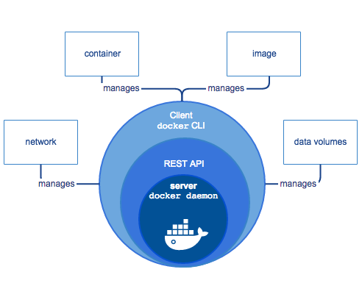
The participants
The following concepts participate in Docker architecture:
The Docker daemon.
The Docker client.
Docker images.
Docker registries.
Docker containers
Image taken from docs.docker.com
Copyright 2017 Trainologic LTD

Slide 7
Hello World
docker run -it ubuntu bash
Copyright 2017 Trainologic LTD

Slide 8
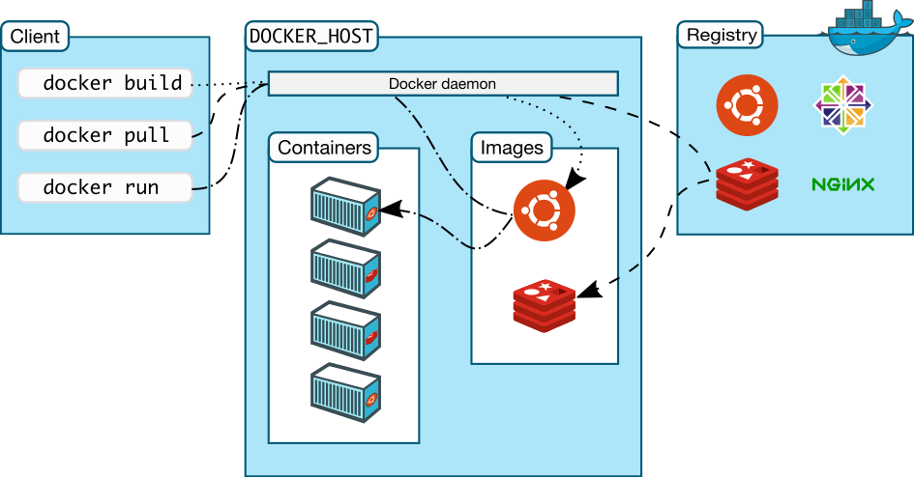
Docker Architecture
Copyright 2017 Trainologic LTD

Slide 9
Docker Daemon and Client
The host process of Docker.
Users interact with the daemon through the Docker client binary
The communication is through REST API
The client can connect from a remote machine
The daemon manages the images and the containers
Copyright 2017 Trainologic LTD

Slide 10
Docker Image
Immutable “Template” for creating containers
The image itself should reside in a Docker registry.
Based on a “Dockerfile” file
Composed of layers – Each “Dockerfile” instruction is a new layer
Copyright 2017 Trainologic LTD

Slide 11
Docker Registry
Manages Docker images.
The main public one is: Docker Hub.
You can create your own private registry.
Main point of distribution
Copyright 2017 Trainologic LTD
Notes:
Show docker hub

Slide 12
Docker Container
A runnable instance of the Docker image
Can be ran, start, stopped or deleted
Secure and isolated application platform
Can be given access to resources on other hosts
Has a state: Created, Stopped, Running
Copyright 2017 Trainologic LTD

Slide 13
Container filesystem
Images are immutable and built from layers
Every container has a r/w layer on top of the image layers
Modifying an existent file in the container:
Go over the layers (from new to old) and find the file
If found, copy to the r/w layer. If not, just create it.
Modify the file.
Copyright 2017 Trainologic LTD

Slide 14
Running containers
Images are immutable and built from layers
docker container run [options] image [command] [args]
More than 80 options! The most useful:
--name – gives the container a name
--rm – removes the container at the end of the
-d – run container in the background
-it – interactive mode
-p [host port:container port]
-v [volume definition] – will be discussed later on
--network will also be discussed later on
Copyright 2017 Trainologic LTD
Notes:
nginx example

Slide 15
Managing Containers
You can list the current containers with the following instruction: docker ps
Will list the running instances.
Use the –a argument to list all the containers (including stopped ones).
To stop/start a container : • docker start/stop [container name]
To remove a container: docker rm [container name]
Copyright 2017 Trainologic LTD
Notes:
Talk about container lifecycle

Slide 16
Debugging containers
Connect to a running container:
docker attach [container] – connects to a running container
docker exec –it [container] /bin/bash – opens bash shell on the specified container
Viewing Docker logs
docker logs [contanier]
Usually combine with --tail #[number of lines] to limit the output
And with --since #[number of minutes ago]m to limit to view recent logs
Configure the Docker daemon to limit the log file
Copyright 2017 Trainologic LTD

Slide 17
Containers as tools
Common use case – instead of installation
docker run --rm –v “$PWD”:/work –w /work <image> <command>
Most tools work in the current directory
- –w /work docker current directory /work
We want the tool to mount the current directory
–v “$PWD”:/work current directory mounted as /work
We want ”one-time” container
--rm
Copyright 2017 Trainologic LTD
Notes:
Pet clinic 101 exercise afterwards

Slide 18
Dockerfile
A Docker image is built from a Dockerfile.
Should reside at SCM
Syntax:
Comments are lines starting with ‘#’.
Every other line is in the format: ‘instruction arguments’.
Let’s see the available instructions…
Copyright 2017 Trainologic LTD

Slide 19
FROM
The first instruction in the file which specifies the base image to build upon.
FROM <base image>
FROM nginx:1.15
Copyright 2017 Trainologic LTD

Slide 20
RUN
runs a command in shell form
RUN <command>
RUN [“exec”, ”arg1”,”arg2”… ]
RUN echo test >> test.txt
Copyright 2017 Trainologic LTD

Slide 21
COPY
Copies file(s) from the context to the image.
COPY <src> <image dst>
COPY server.py /server.py
COPY server/*.py /server/
Copyright 2017 Trainologic LTD

Slide 22
Entrypoint/CMD
Will define an executable to run when running the container.
Any arguments to the ‘docker run’ command will be appended to the entrypoint.
There can be only one entrypoint in the dockerfile.
You can use CMD once in your dockerfile to provide default arguments for the entrypoint.
So when should I use an ENTRYPOINT ? And when a CMD?
Copyright 2017 Trainologic LTD
Notes:
Show an example of the flask server

Slide 23
Entrypoint vs CMD
CMD is easily overridden – use it for ”flexible” general purpose images
Java image
Maven image
Entrypoint wraps your parameters – use it when you want to create an “executable”
Used for tools
For micro-services
Copyright 2017 Trainologic LTD
Notes:
https://www.ctl.io/developers/blog/post/dockerfile-entrypoint-vs-cmd/

Slide 24
Entrypoint/CMD format
Two ways to define entrypoint/cmd
Shell form:
ENTRYPOINT app param1 param2
CMD app param1 param2
Prepends /bin/bash –c to the command
Doesn’t allow CMD override
Exec form (preferred form):
ENTRYPOINT [“app”, “param1”,”param2”]
CMD [“app”,”param1”,”param2”]
Enables overriding CMD by using docker run command
Copyright 2017 Trainologic LTD
Notes:
Show the example of stopping a container

Slide 25
Labels
We want to have as much metadata as we can on our image:
CI job id
Git commit
The user that built it
Git branch and more..
And we want to be able to filter this data
Add LABEL <label name>=<label value>
Good convention for label name is to use company name as prefix: LABEL com.trainologic.version=0.1.0
Copyright 2017 Trainologic LTD

Slide 26
Instructions
FROM – the first instruction in the file which specifies the base image to build upon.
MAINTAINER – the author of the image.
RUN <command> -- runs a command in shell form.
RUN [“exec”, “arg1”, …] – runs a command in exec form.
CMD – discussed later.
LABEL key=value key=value – adds metadata to the image.
Copyright 2017 Trainologic LTD

Slide 27
Instructions
ADD – adds file(s) from the context to the image. You can use regex and even urls.
COPY – same as ADD but without URL and tar handling.
ENTRYPOINT – discussed later.
VOLUME “/dir” – creates a mount point for externally mounted volumes.
USER – sets the user for the next instructions.
WORKDIR – sets the working directory for the next instructions.
Copyright 2017 Trainologic LTD

Slide 28
Building Images
docker build [options] PATH | URL
Builds the Docker image from a “Dockerfile” and a the files located in the path/URL
Searches for “Dockerfile” file by default or use –f [other docker file] option to specify the Dockerfile
The URL can point to:
GIT repository
Plaintext file
Tarball context
Copyright 2017 Trainologic LTD
Notes:
Talk about how docker actually build the container
Talk about the context and docker ignore

Slide 29
Image filesystem
Docker uses Union FS which is layered.
This means that a Docker image will only contain the difference from the parent image.
You can deploy thousands of containers from the same image without “almost” any additional cost.
Uses CoW strategy – if a file from a sublayer is being modified, it is copied to a new layer
Copyright 2017 Trainologic LTD
Notes:
https://docs.docker.com/engine/userguide/storagedriver/imagesandcontainers/#container-and-layers
We will talk later how the r/w layer of the container is relevant here

Slide 30
Tagging Images
Tag format:
REGISTRY[:PORT]/NAMESPACE/REPOSITORY[:TAG]
Tagging is used for image information and versioning
docker tag 0e5574283393 service:1.0
For aliasing
docker tag myApp/service:1.0.5 myApp/service:1.0
For publishing to a specific registry
docker tag service:1.0 myRegistry:5000/myApp/service:1.0
Copyright 2017 Trainologic LTD

Slide 31
Docker networking
3 builtin networks: none, host, bridge
none – the container in this network lacks a network interface
host – the container in this network shares the host network
A port exposed in the container will be exposed in the host
bridge – the default - a docker0 network interface
Containers that run in this network can access one another by ip
Doesn’t support discovery
Users can define custom bridge networks – in this case discovery is supported
Copyright 2017 Trainologic LTD

Slide 32
Docker networking
overlay – connects several Docker daemons together.
Used by Docker swarm
Removes the need for OS level routing
macvlan – provides a physical MAC address to every container virtual interface
Good for legacy applications that require physical address
Copyright 2017 Trainologic LTD

Slide 33
Docker compose
docker-compose is a tool for managing a group of containers on a single host using YAML specification
The main component in compose is the service
The service defines
Which image to use and how to build it if needed
Ports, volumes, env vars and networking
Dependencies between containers
Copyright 2017 Trainologic LTD

Slide 34
Docker compose
In the docker-compose yml folder:
up – creates and starts the containers
stop – stops the containers
kill – kills the containers
use docker-compose –-help for more commands
Copyright 2017 Trainologic LTD

Slide 35
Controlling container behaviour
What should it do on container stop - restart!
Using restart:
no – never restarts
always – always restarts
on-failure – when container stops with error (non-zero exit code)
unless-stopped – restart unless stopped from outside
Copyright 2017 Trainologic LTD

Slide 36
Controlling start up order
Service A depends on Service B
we can specify:
depends_on : serviceB
Not Good Enough!
Always assume that your resources may not be available
Copyright 2017 Trainologic LTD

Slide 37
Links
https://github.com/ColonelLanda/docker-meetup-2018
https://github.com/ColonelLanda/hello-app-docker
https://github.com/Trainologic/docker-webinar

Slide 38
Controlling start up order
Service A depends on Service B
we can specify:
depends_on : serviceB
Not Good Enough!
Always assume that your resources may not be available
Copyright 2017 Trainologic LTD

